Slide 1
Unit 3 Lec1 Concept of population and sample, sampling techniques, estimation, confidence intervals, chi-square test, ANOVA, non-parametric tests), p-values and interpretation.
Population: A population is the complete set of all observations or individuals that we want to study.
Population Metrics (N)
Mean (μ)
Variance (σ²)
Standard deviation (σ)
Examples All students in a university
All households in India
All blood samples from patients
Example 1 Suppose we want to know average height of all students in India.
Population = all students in India
Studying the whole population is usually impossible or expensive.

Slide 2
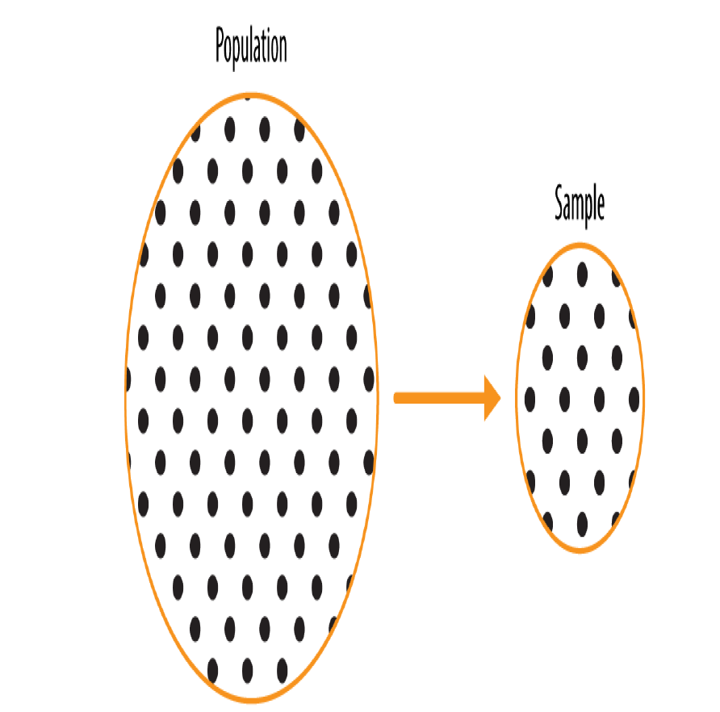
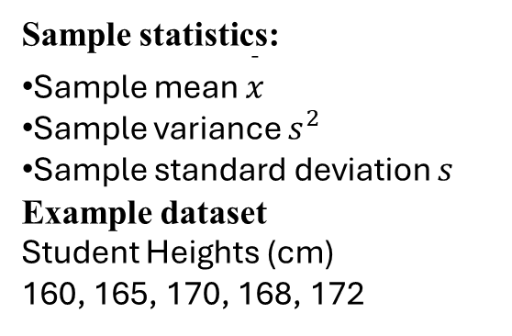
Sample
A sample is a subset of the population selected for analysis.
Example If we measure height of 100 students from different colleges, that is a sample.
Sample statistics:
Sample mean $\overset{ˉ}{x}$
Sample variance $s^{2}$
Sample standard deviation $s$
Example dataset
Student Heights (cm)
160, 165, 170, 168, 172
Random Sampling and Sample Bias
A sample is a subset of data from a larger data set; statisticians call this larger data set
the population.

Slide 3
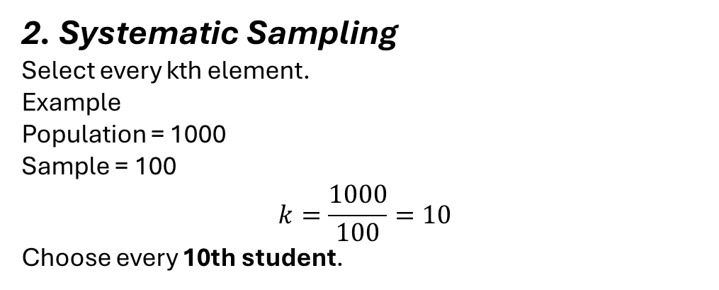
Sampling Techniques
1. Random sampling is a process in which each available member of the population
being sampled has an equal chance of being chosen for the sample at each draw. The
sample that results is called a simple random sample.
Example Select 50 students randomly using random numbers.
Advantages
No bias
Easy statistical analysis
2. Systematic Sampling
Select every kth element.
Example Population = 1000 Sample = 100
$$k=\frac{1000}{100}=10$$
Choose every 10th student.

Slide 4
(c) Stratified Sampling
Population divided into groups (strata).
Example Students grouped by department:
CSE
Mechanical
Civil
Then random sample from each group.
Advantage Improves representation.

Slide 5
Estimation
Estimation is a fundamental concept in statistical inference, where we use information from a sample to estimate unknown characteristics of a population.
Since collecting data from the entire population is often impractical or impossible, estimation allows researchers to draw conclusions about the population using only a subset of data.
Definition: Estimation is the process of approximating the value of an unknown population parameter based on sample data.
Population parameters are fixed but unknown values describing a population, such as:
Population mean (μ)
Population variance (σ²)
Population standard deviation (σ)
Population proportion (P)
A sample statistic is calculated from the sample and used to estimate these parameters.

Slide 6
Example 1:
Suppose we want to know the average protein intake of all adults in India.
Population: All adults in India Sample: 500 adults surveyed
If the sample mean protein intake is 52 grams, we use it to estimate the population mean. Thus:
μ ≈ 52 grams
This approximation is called estimation.

Slide 7
Types of Estimation
There are two main types of estimation:
Point Estimation
Interval Estimation
A point estimate is a single numerical value used to estimate a population parameter.
Example: Sample mean = 52 grams. Then:
Population mean ≈ 52 grams
The value 52 is the point estimate.
Examples of Point Estimators
Population Parameter | Symbol | Point Estimator
Population Mean | μ | Sample Mean (x̄)
Population Variance | σ² | Sample Variance (s²)
Population Standard Deviation | σ | Sample Standard Deviation (s)
Population Proportion | P | Sample Proportion (p̂)

Slide 8
Interval Estimation
A point estimate alone is not sufficient, because it does not indicate how accurate the estimate is.
Therefore, we use interval estimation, which gives a range of values within which the population parameter likely lies.
Example:
Estimated mean sodium level = 80 mg
Instead of saying:
μ = 80
We say:
μ lies between 75 and 85 mg
This range is called a confidence interval.

Slide 9
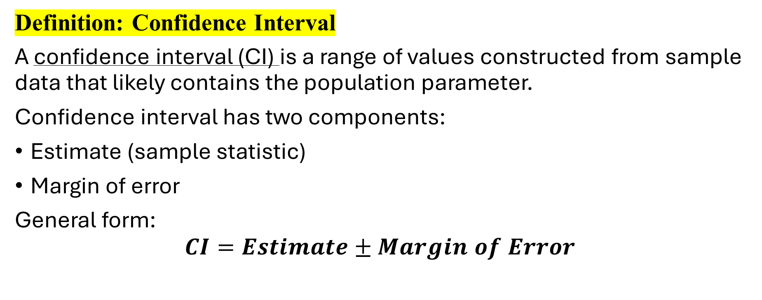
Definition: Confidence Interval
A confidence interval (CI) is a range of values constructed from sample data that likely contains the population parameter.
Confidence interval has two components:
Estimate (sample statistic)
Margin of error
General form:
$$CI=Estimate±Margin of Error$$

Slide 10
Confidence Level
Confidence level indicates how certain we are that the interval contains the true parameter.
Common confidence levels:
Confidence Level | Z value
90% | 1.645
95% | 1.96
99% | 2.576
A 95% confidence level means:
If we repeatedly draw samples and construct intervals, 95% of them will contain the true population parameter.

Slide 11
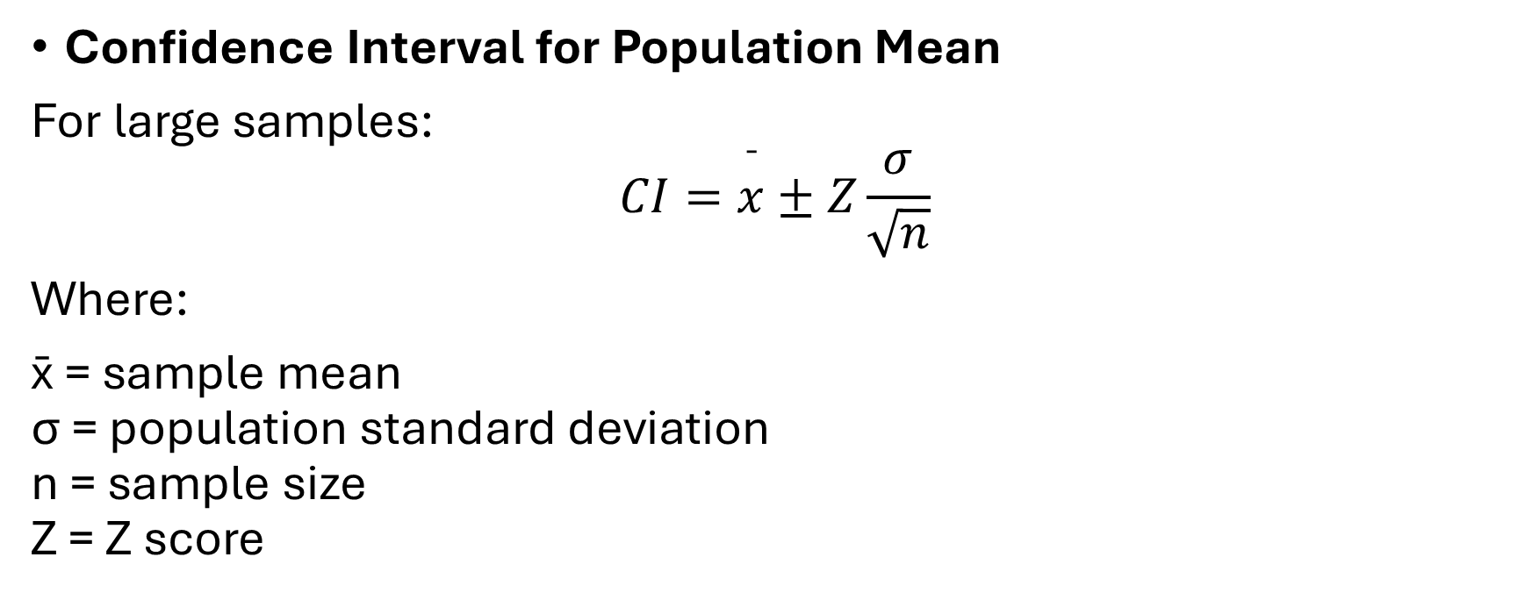
Confidence Interval for Population Mean
For large samples:
$$CI=\overset{ˉ}{x}±Z\frac{σ}{\sqrt{n}}$$
Where:
x̄ = sample mean σ = population standard deviation n = sample size Z = Z score

Slide 12
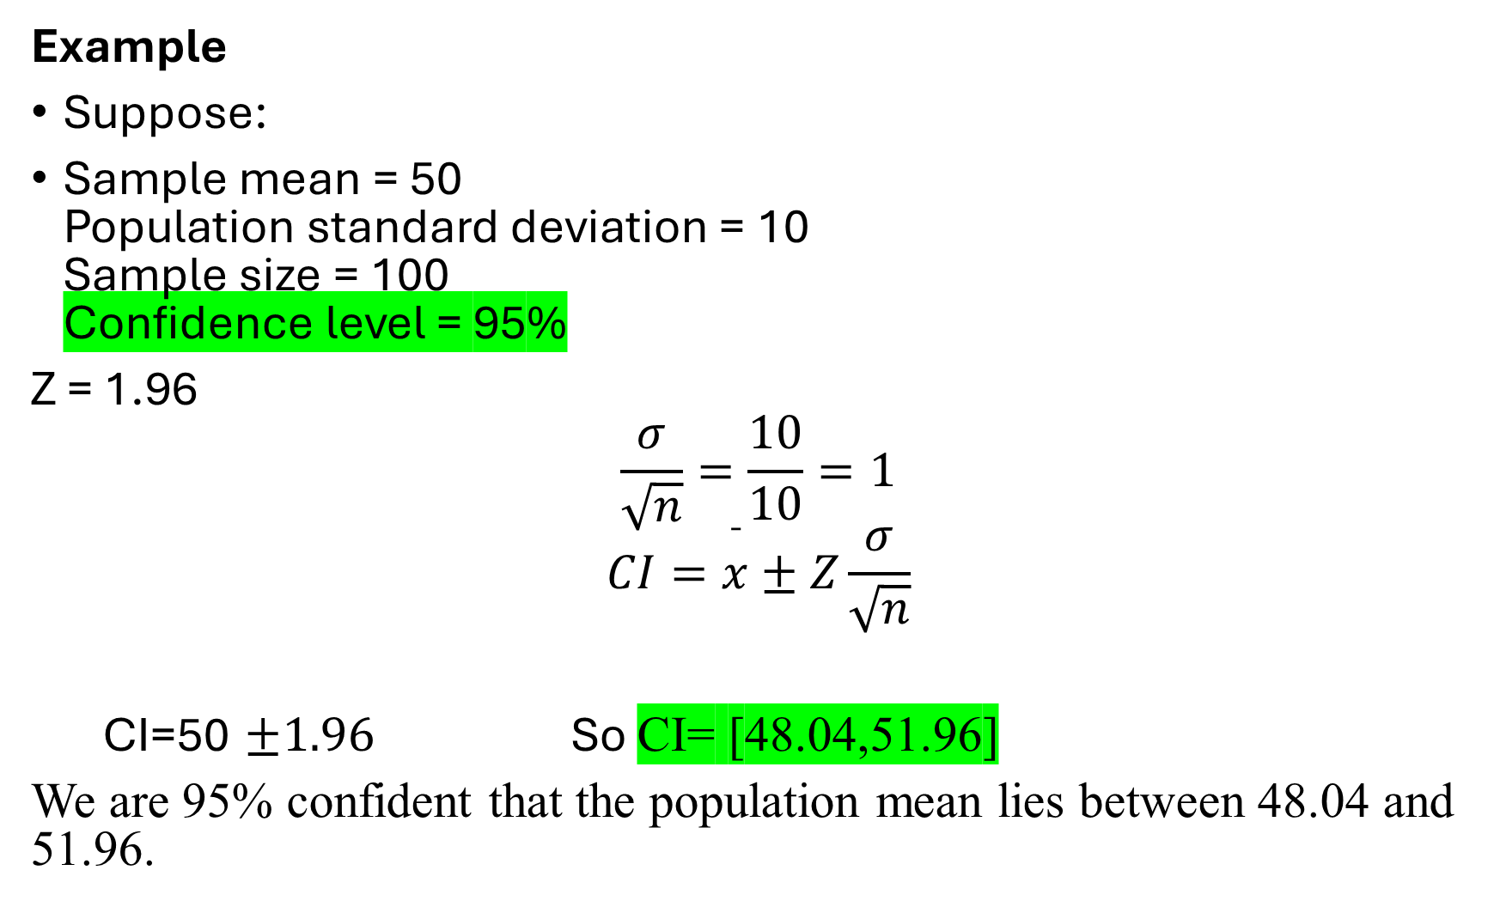
Example
Suppose:
Sample mean = 50 Population standard deviation = 10 Sample size = 100 Confidence level = 95%
Z = 1.96
$$\frac{σ}{\sqrt{n}}=\frac{10}{10}=1$$
$$CI=\overset{ˉ}{x}±Z\frac{σ}{\sqrt{n}}$$
CI=50 $±1.96$ So CI= [48.04,51.96]
We are 95% confident that the population mean lies between 48.04 and 51.96.

Slide 13

Example 3
A sample of 100 food items has an average sodium content of 80 mg. The Population standard deviation = 10 mg. Construct a 95% confidence interval for the population mean.
$$CI=\overset{ˉ}{x}±Z\frac{σ}{\sqrt{n}}$$
Where
x̄ = 80 σ = 10 n = 100 Z = 1.96 (for 95%)
CI=[78.04,81.96]

Slide 14
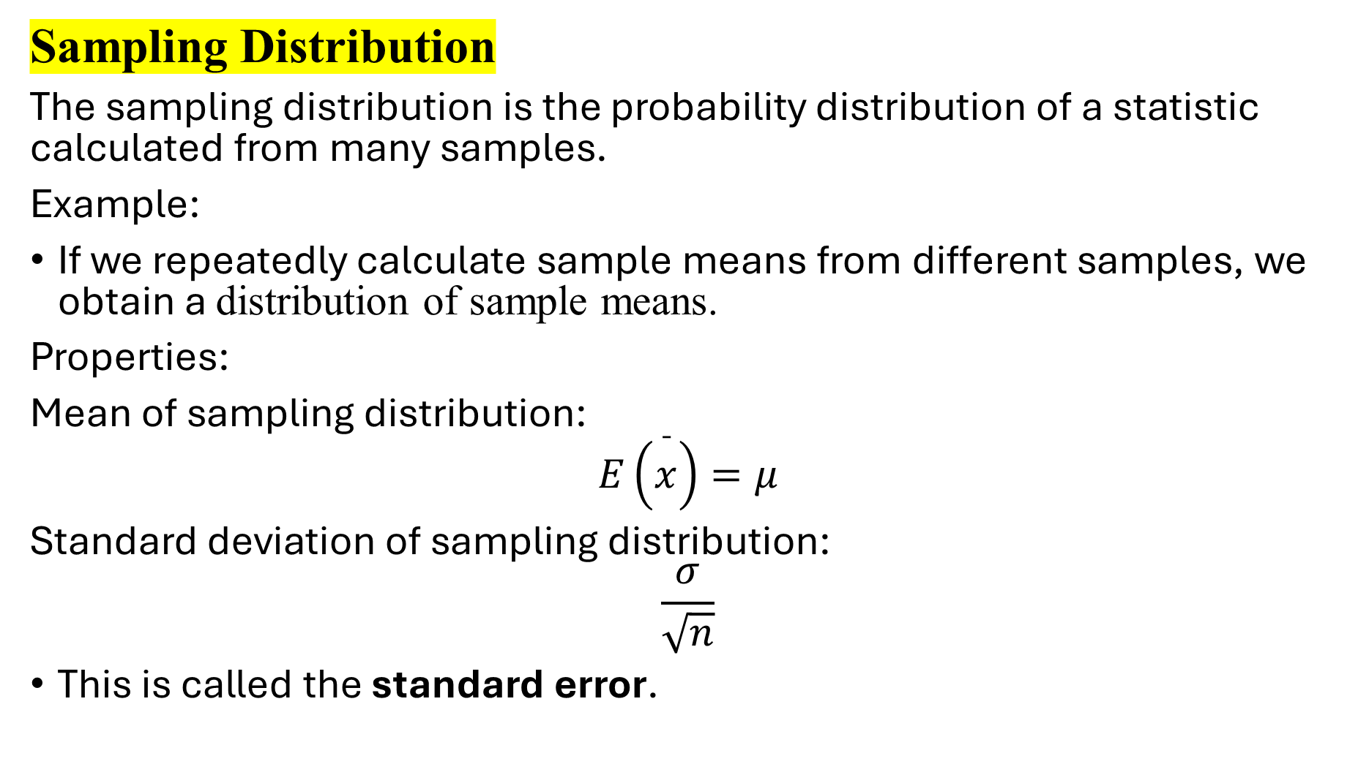
Sampling Distribution
The sampling distribution is the probability distribution of a statistic calculated from many samples.
Example:
If we repeatedly calculate sample means from different samples, we obtain a distribution of sample means.
Properties:
Mean of sampling distribution:
$$E\left(\overset{ˉ}{x}\right)=μ$$
Standard deviation of sampling distribution:
$$\frac{σ}{\sqrt{n}}$$
This is called the standard error.

Slide 15
Sampling Distribution of the Mean Example
Example 1.Imagine you draw a random sample of 10 apples.
(101,102,103,103,104,107,100,96,80,100),
Then you calculate the mean of that sample as 91.6 grams. That’s one sample mean from one sample. However, you realize that if you were to draw another sample, you’d obtain a different mean. A third sample would produce yet another mean. And so on.
.With this in mind, suppose you decide to collect 50 random samples of the same apple population. Each sample contains 10 apples, and you calculate the mean for each sample.
you have 50 sample means for apple weights

Slide 16
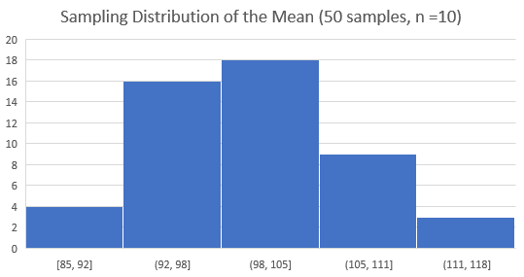
At this point, you have 50 sample means for apple weights. You plot these sample means in the histogram below to display your sampling distribution of the mean.

Slide 17
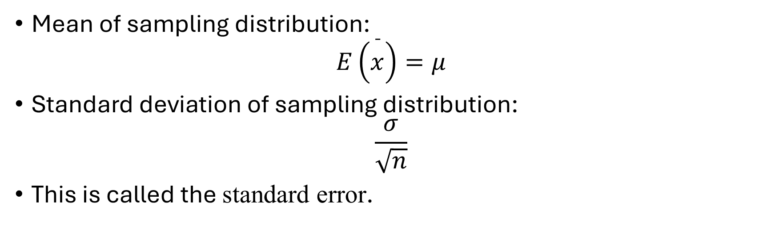
Mean of sampling distribution:
$$E\left(\overset{ˉ}{x}\right)=μ$$
Standard deviation of sampling distribution:
$$\frac{σ}{\sqrt{n}}$$
This is called the standard error.

Slide 18
Central Limit Theorem (CLT)
The Central Limit Theorem is extremely important in estimation.
It states that:
If the sample size is sufficiently large (usually n ≥ 30), the sampling distribution of the sample mean approaches a normal distribution, regardless of the population distribution.
This allows us to construct confidence intervals and perform hypothesis testing.

Slide 19
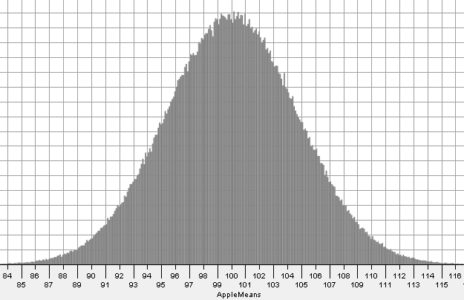

Slide 20
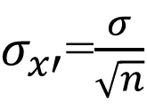
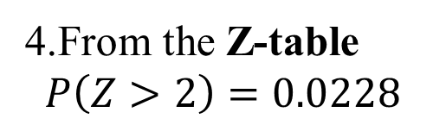
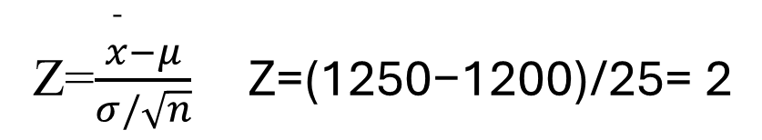

Example: A factory produces light bulbs whose mean lifetime is 1200 hours with a SD of 200 hours. A random sample of 64 light bulbs is selected. What is the probability that the sample mean lifetime of the bulbs is greater than 1250 hours?
Sol: Population mean μ=1200
Population standard deviation σ=200
Sample size n=64
1. Use Central Limit Theorem The sampling distribution of the sample mean will be approximately normal with:
$$μ_{\overset{ˉ}{x}}=μ=1200$$
$σ_{x′}$=$\frac{σ}{\sqrt{n}}$
​200/$\sqrt{64}$​=200/8=25
Convert to Z-score
From the Z-table
$$P\left(Z>2\right)=0.0228$$
Z=$\frac{\overset{ˉ}{x}−μ}{σ/\sqrt{n}} \text{Z}\text{=(}\text{1250}\text{−}\text{1200}\text{)/}\text{25}\text{= }\text{2​}$
So, there is about 2.28% probability that the sample mean lifetime of the 64 bulbs exceeds 1250 hours.

Slide 21
Hypothesis Testing
A hypothesis is simply a testable statement about a population parameter that we verify using sample data.
Definition. A hypothesis is a statement about a population parameter that can be tested using sample data.
A statistical hypothesis is an assumption or claim about a population parameter such as:
population mean (μ)
population proportion (p)
population variance (σ²)
Since it is usually impossible to study an entire population, we collect a sample and use statistical tests to determine whether the claim about the population is likely true.

Slide 22
Why is Hypothesis needed
In real life we constantly test claims. Examples
Situation | Hypothesis
Medicine | A new drug (D1) cures disease faster
Education | Online learning improves performance
Agriculture | New fertilizer increases crop yield
Business | A new advertisement increases sales
Since these claims cannot be verified with the entire population, we test them statistically using hypothesis testing.

Slide 23
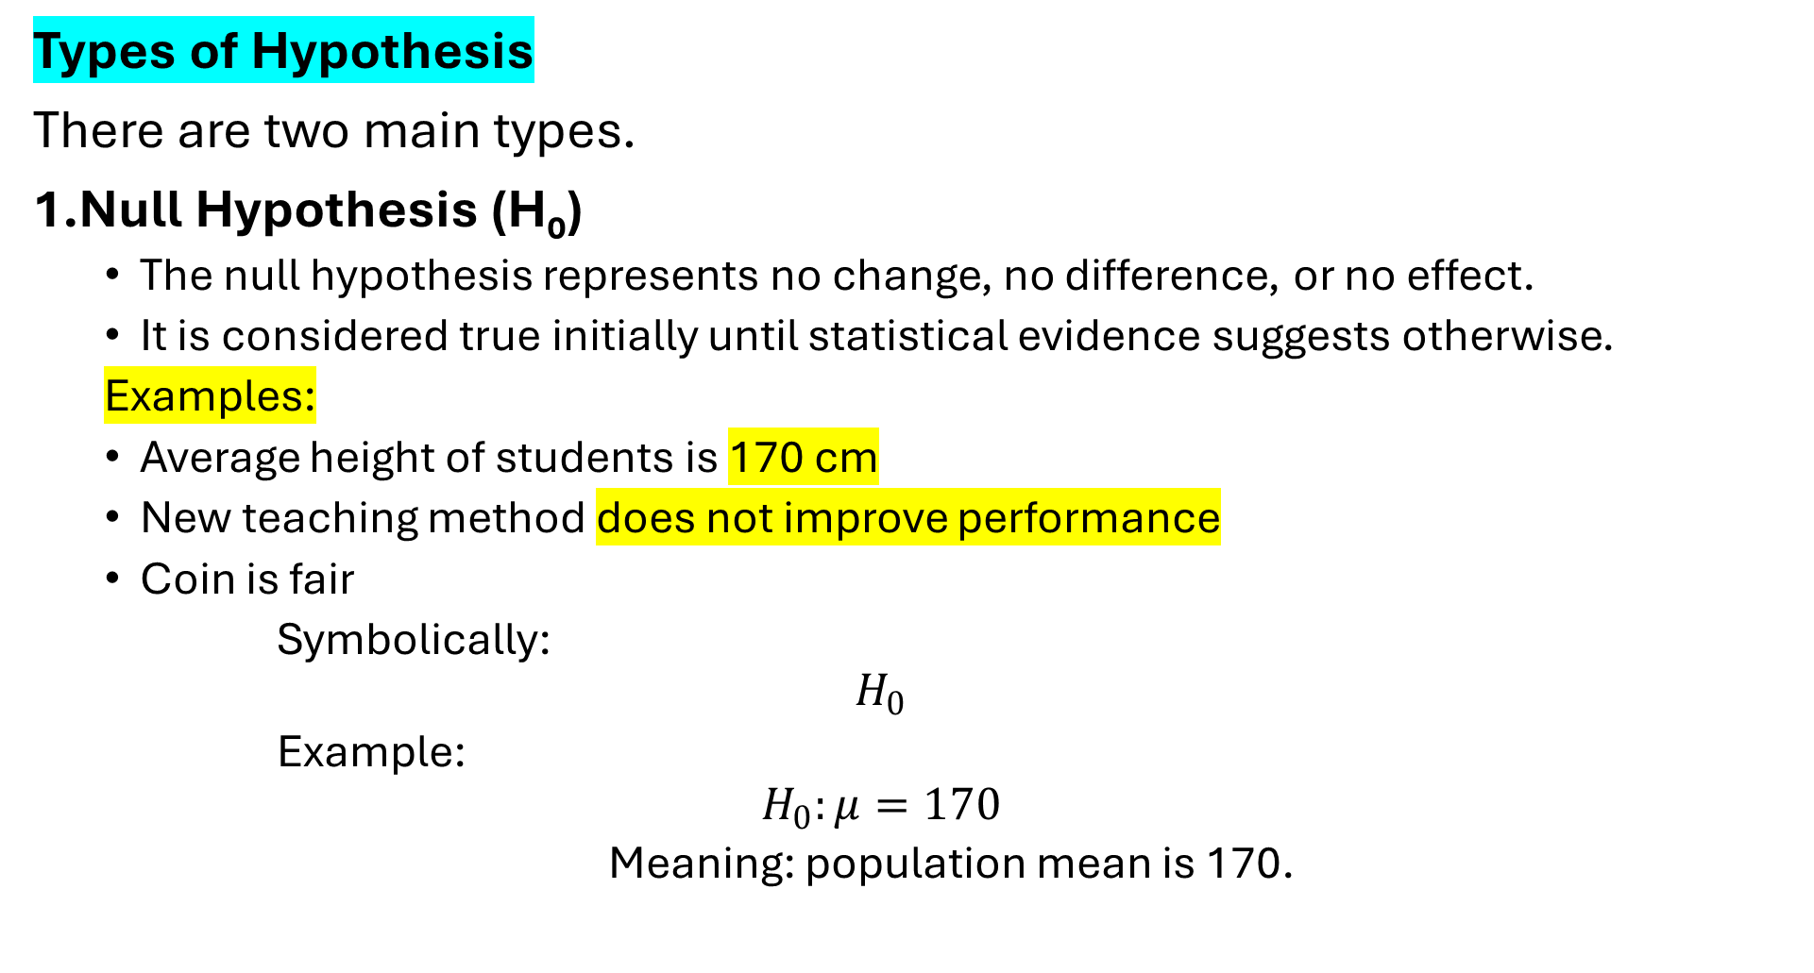
Types of Hypothesis
There are two main types.
1.Null Hypothesis (H₀)
The null hypothesis represents no change, no difference, or no effect.
It is considered true initially until statistical evidence suggests otherwise.
Examples:
Average height of students is 170 cm
New teaching method does not improve performance
Coin is fair
Symbolically:
$$H_{0}$$
Example:
$$H_{0}:μ=170$$
Meaning: population mean is 170.

Slide 24
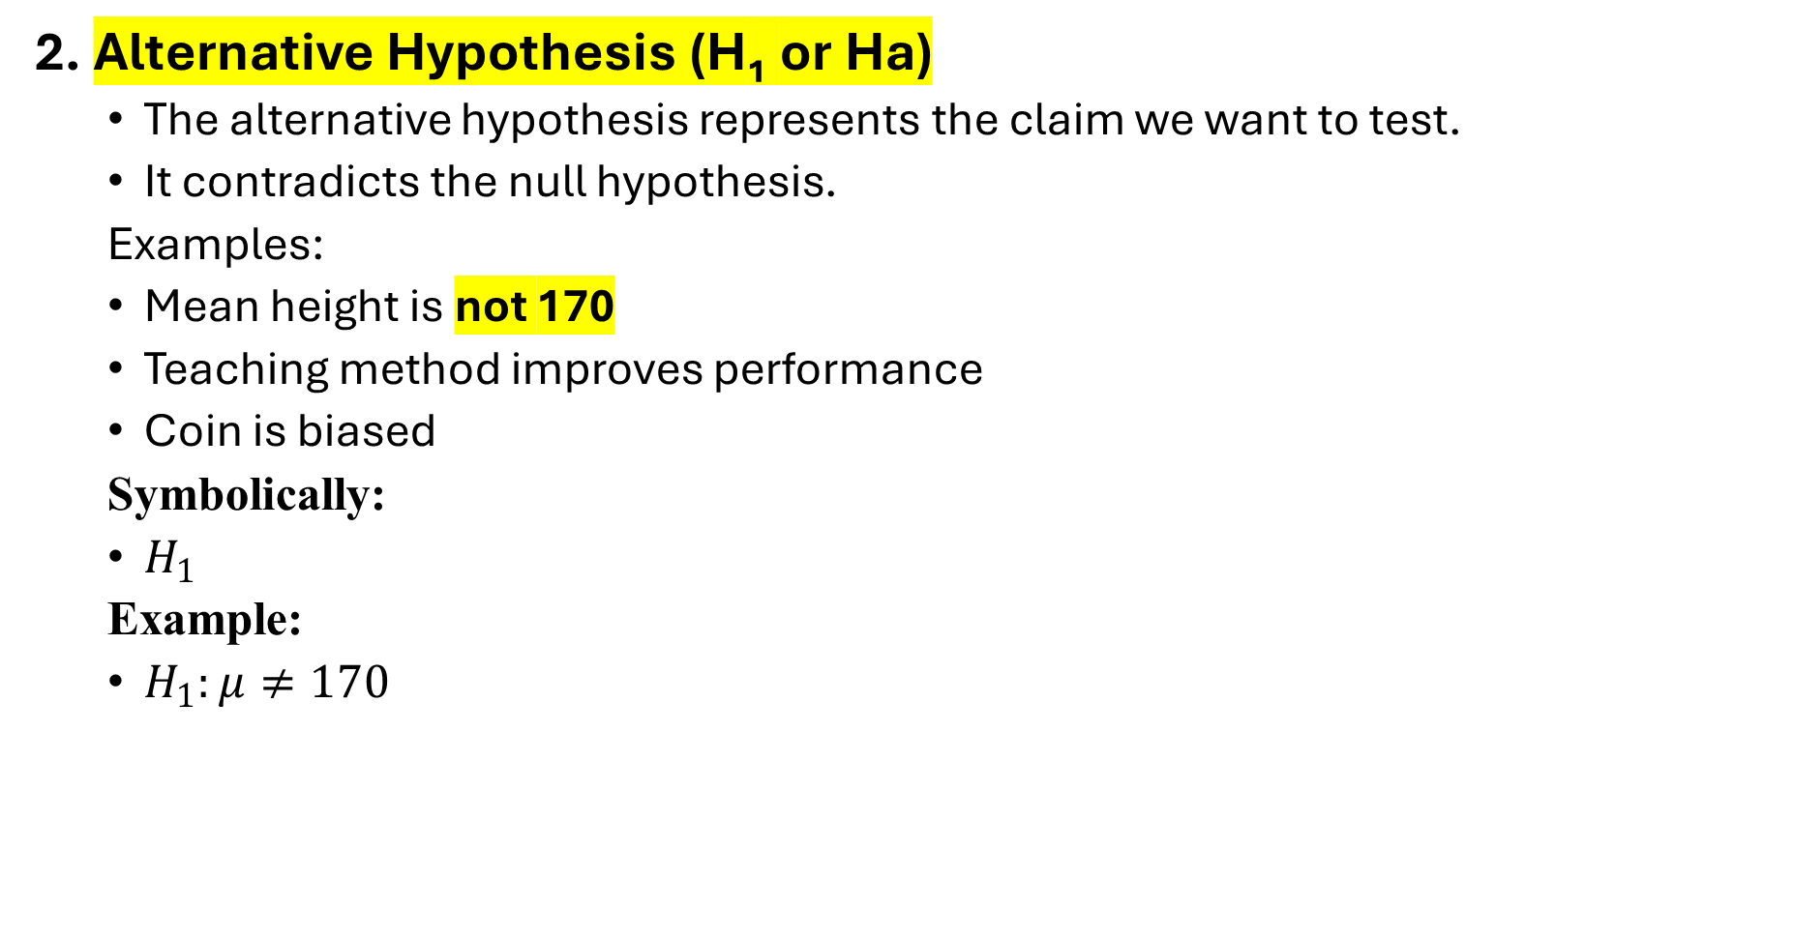
2. Alternative Hypothesis (H₁ or Ha)
The alternative hypothesis represents the claim we want to test.
It contradicts the null hypothesis.
Examples:
Mean height is not 170
Teaching method improves performance
Coin is biased
Symbolically:
$H_{1}$
Example:
$H_{1}:μ≠170$

Slide 25
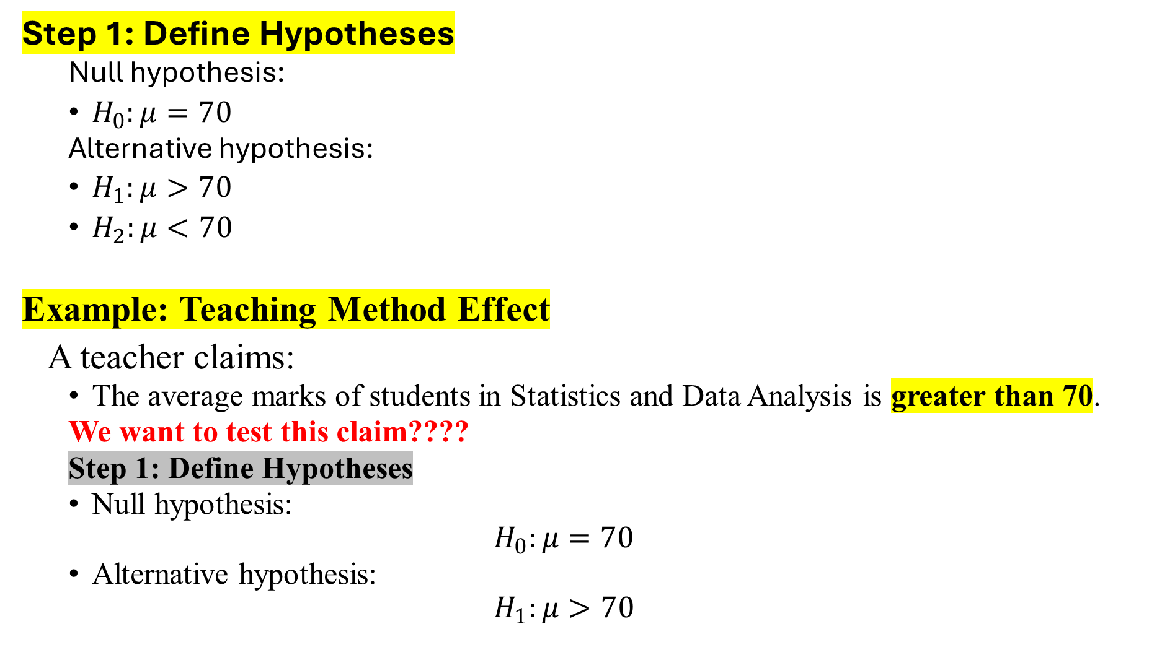
Step 1: Define Hypotheses
Null hypothesis:
$H_{0}:μ=70$
Alternative hypothesis:
$H_{1}:μ>70$
$H_{2}:μ<70$
Example: Teaching Method Effect
A teacher claims:
The average marks of students in Statistics and Data Analysis is greater than 70.
We want to test this claim????
Step 1: Define Hypotheses
Null hypothesis:
$$H_{0}:μ=70$$
Alternative hypothesis:
$$H_{1}:μ>70$$

Slide 26
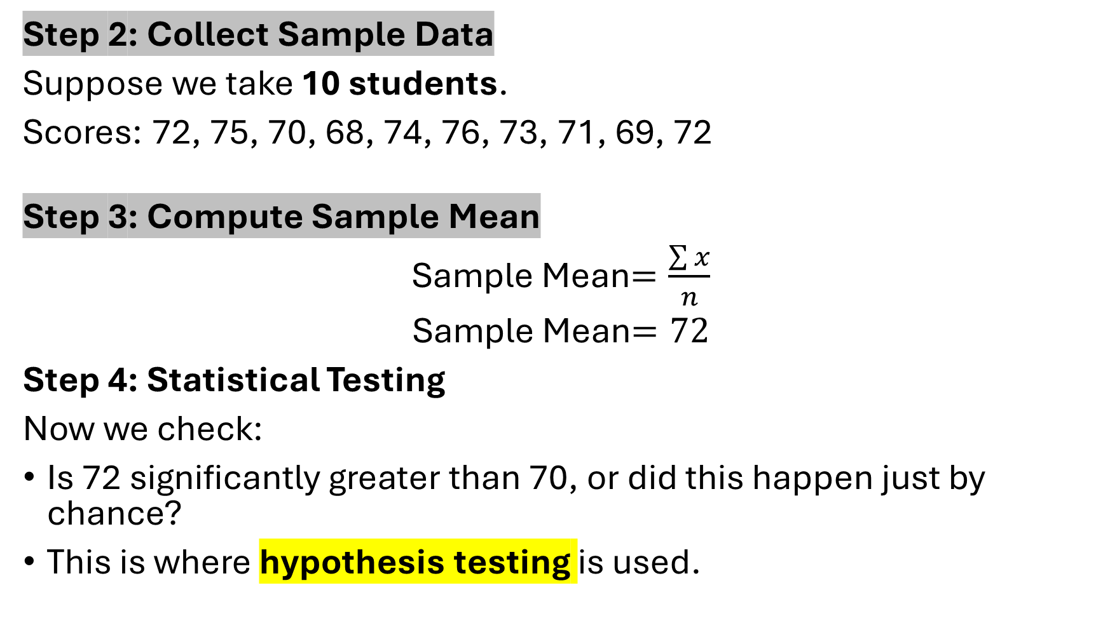
Step 2: Collect Sample Data
Suppose we take 10 students.
Scores: 72, 75, 70, 68, 74, 76, 73, 71, 69, 72
Step 3: Compute Sample Mean
Sample Mean$=\frac{\sum{x}}{n}$
Sample Mean$=72$
Step 4: Statistical Testing
Now we check:
Is 72 significantly greater than 70, or did this happen just by chance?
This is where hypothesis testing is used.

Slide 27
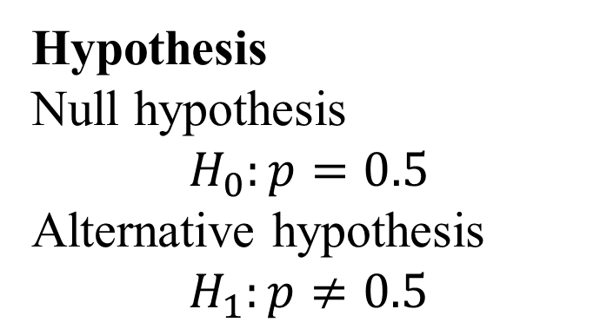
Step 5: Decision
If statistical test shows strong evidence, we:
Reject H₀
Otherwise we:
Fail to reject H₀.
Hypothesis
Null hypothesis
$$H_{0}:p=0.5$$
Alternative hypothesis
$$H_{1}:p≠0.5$$
Example 2 (Coin Toss)
Suppose someone claims:
The coin is fair.
Question: Is this difference due to random chance, or is the coin biased?
Statistical tests help answer this.

Slide 28
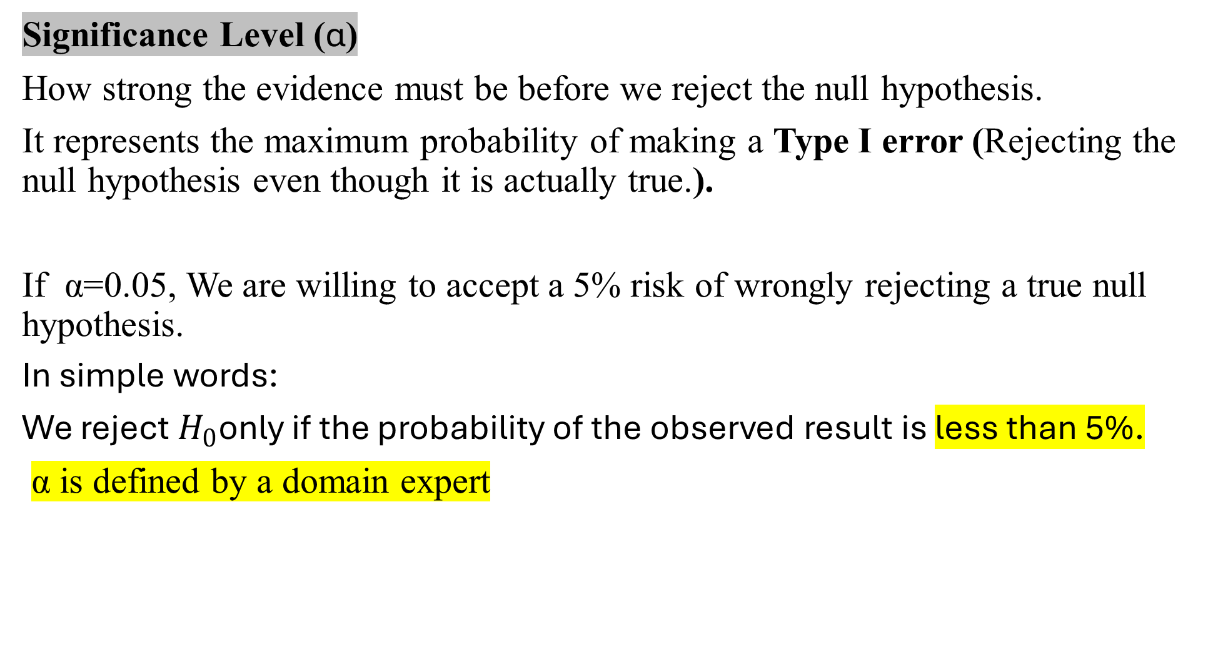
Significance Level (α)
How strong the evidence must be before we reject the null hypothesis.
It represents the maximum probability of making a Type I error (Rejecting the null hypothesis even though it is actually true.).
If α=0.05, We are willing to accept a 5% risk of wrongly rejecting a true null hypothesis.
In simple words:
We reject $H_{0}$only if the probability of the observed result is less than 5%.
α is defined by a domain expert

Slide 29
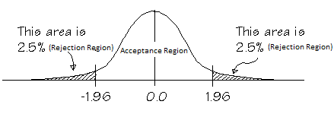
If α=0.20, what will be the confidence interval
100%-20%=80% (Confidence), Meaning 10% left side and 10% right side will be the rejection region and 80% will be the confidence interval

Slide 30
Type 1 and Type 2 error
In hypothesis testing, when we make decisions using sample data, there is always a possibility of making wrong conclusions. These mistakes are called statistical errors.
There are two types of errors:
Type I Error: A Type I Error occurs when we reject the null hypothesis even though it is actually true.
Type II Error: A Type II Error occurs when we fail to reject the null hypothesis even though it is false.

Slide 31
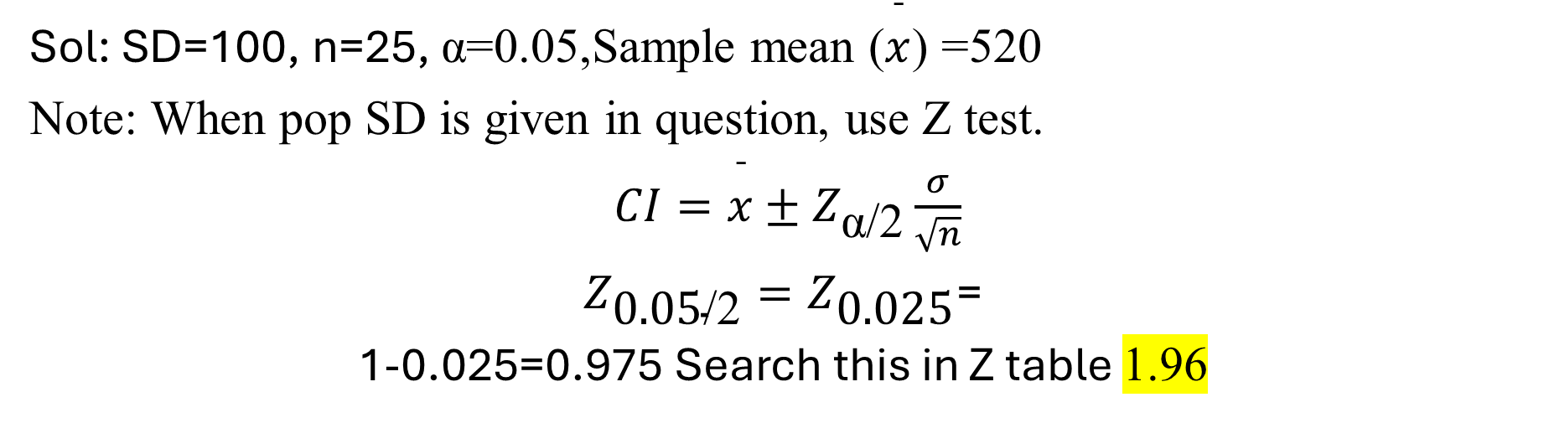
Example 1: Students in SDA have 85% marks in the subject. A sample of 150 students was taken and it was found that the avg marks was 88%. With SD of 4%. Does the marks rate differ from the actual. Significance value 0.05
One tail
Two tail test
Example 1: Students in Neet appear in an exam. The SD=100 and a sample of 25 test takers are chosen who have a mean score of 520. Construct a 95% CI.
Sol: SD=100, n=25, α=0.05,Sample mean ($\overset{ˉ}{x}$) =520
Note: When pop SD is given in question, use Z test.
$CI=\overset{ˉ}{x}±Z_{\text{α}\text{/}\text{2}}\frac{σ}{\sqrt{n}}$
$Z_{\text{0.05}\text{/}\text{2}}=Z_{\text{0.025}}$=
1-0.025=0.975 Search this in Z table 1.96

Slide 32
CI=520+1.96(100/root(25)) =559.2
CI=520-1.96(100/root(25))=480.8
CI=[480.8, 559]
Note: what if Pop. SD is not given then we use a test called as t-test
Situation | Test Used
Population standard deviation known | Z-test / Z-confidence interval
Population standard deviation unknown | t-test / t-confidence interval
Sample size large (n ≥ 30){unfortunately we used 25 in the example} | Z-test often used
Sample size small (n < 30) | t-test preferred

Slide 33
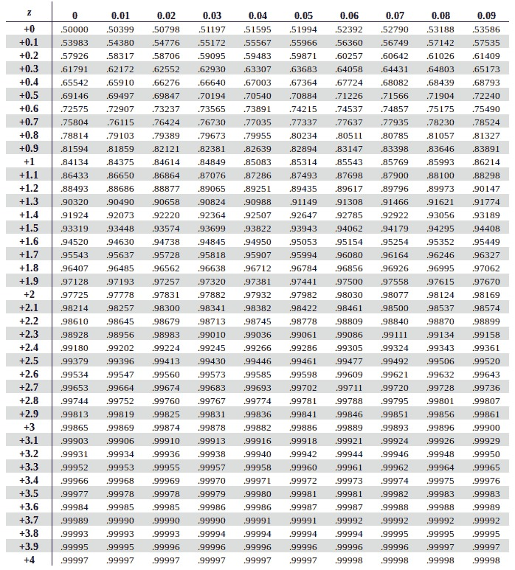

Slide 34
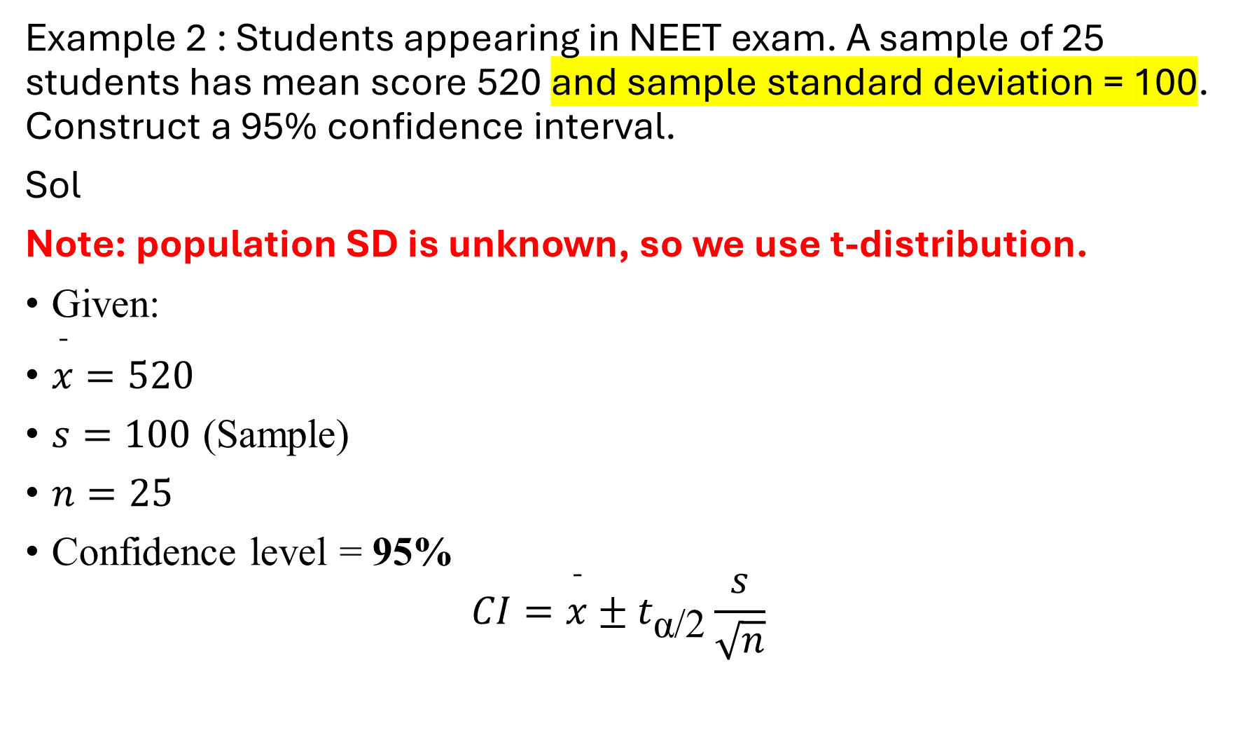
Example 2 : Students appearing in NEET exam. A sample of 25 students has mean score 520 and sample standard deviation = 100. Construct a 95% confidence interval.
Sol
Note: population SD is unknown, so we use t-distribution.
Given:
$\overset{ˉ}{x}=520$
$s=100$ (Sample)
$n=25$
Confidence level = 95%
$$CI=\overset{ˉ}{x}±t_{\text{α}\text{/}\text{2}}\frac{s}{\sqrt{n}}$$

Slide 35
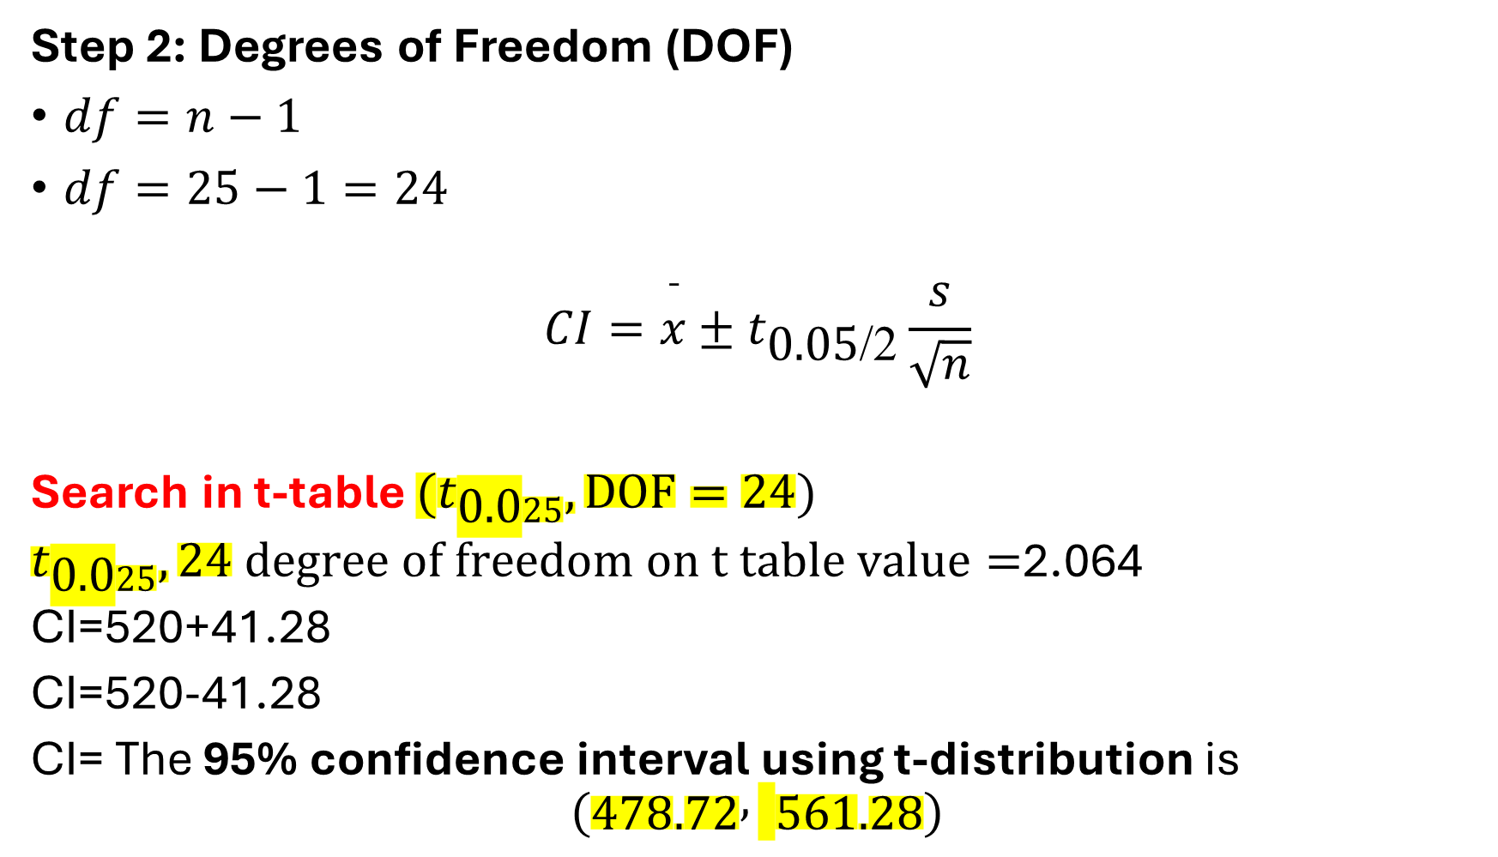
Step 2: Degrees of Freedom (DOF)
$df=n−1$
$df=25−1=24$
$$CI=\overset{ˉ}{x}±t_{\text{0}\text{.}\text{05}\text{/}\text{2}}\frac{s}{\sqrt{n}}$$
Search in t-table ${(t}_{\text{0.0}25},DOF=24)$
$t_{\text{0.0}25},24 degree of freedom on t table value=$2.064
CI=520+41.28
CI=520-41.28
CI= The 95% confidence interval using t-distribution is
$$\left(478.72 , 561.28\right)$$

Slide 36
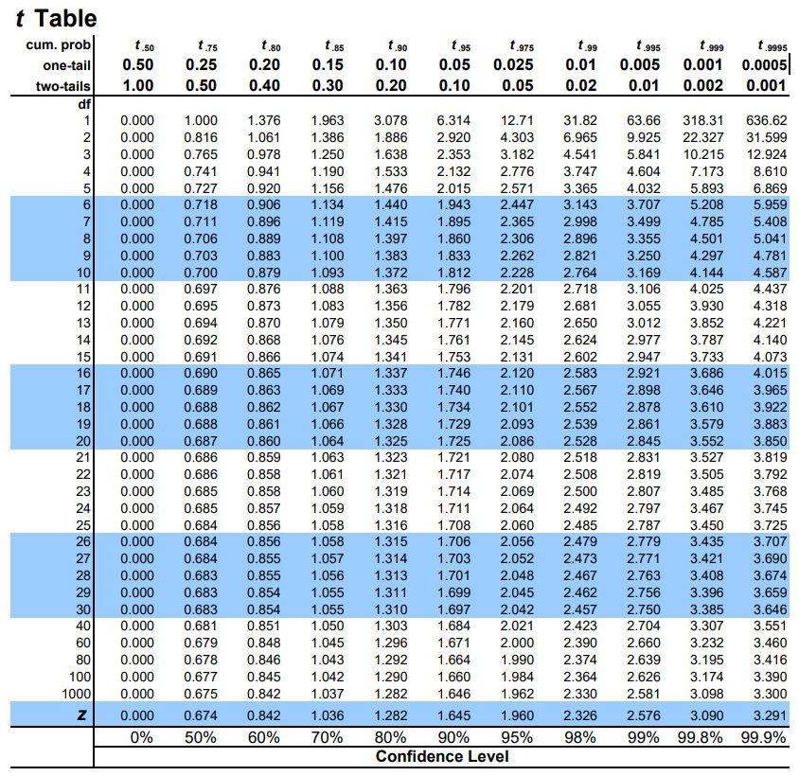

Slide 37
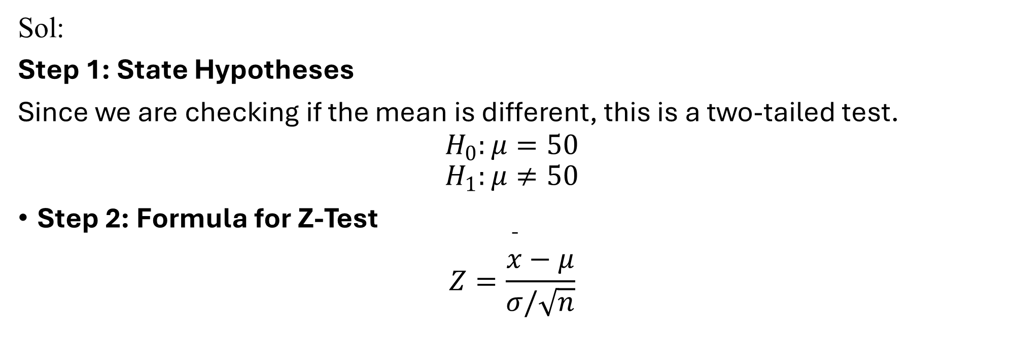
Example: A soft drink company claims that the average sugar content in its bottle is 50 grams. A nutrition researcher tests 40 bottles and finds the sample mean = 47 grams. The population standard deviation is known = 8 grams. Test at 5% level of significance whether the company’s claim is correct.
Sol:
Step 1: State Hypotheses
Since we are checking if the mean is different, this is a two-tailed test.
$$H_{0}:μ=50$$
$$H_{1}:μ≠50$$
Step 2: Formula for Z-Test
$$Z=\frac{\overset{ˉ}{x}−μ}{σ/\sqrt{n}}$$

Slide 38
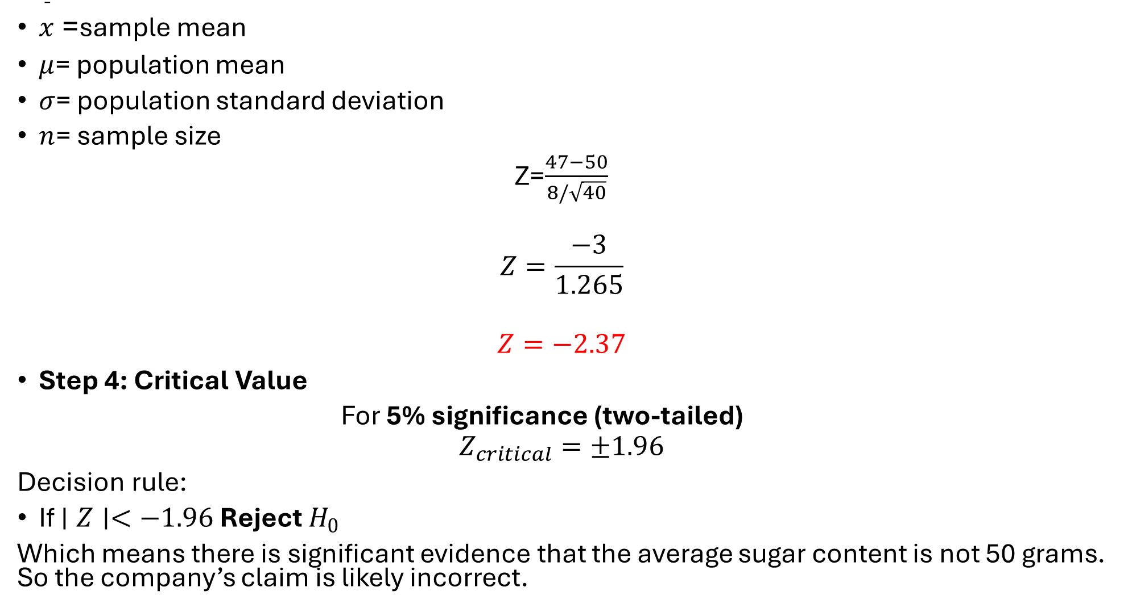
$\overset{ˉ}{x}$= sample mean
$μ$= population mean
$σ$= population standard deviation
$n$= sample size
Z=$\frac{47−50}{8/\sqrt{40}}$
$$Z=\frac{−3}{1.265}$$
$$Z=−2.37$$
Step 4: Critical Value
For 5% significance (two-tailed)
$$Z_{critical}=±1.96$$
Decision rule:
If $∣Z∣<−1.96$Reject $H_{0}$
Which means there is significant evidence that the average sugar content is not 50 grams. So the company’s claim is likely incorrect.

Slide 39
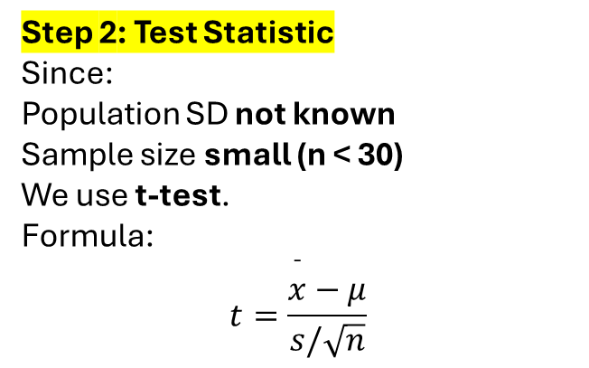
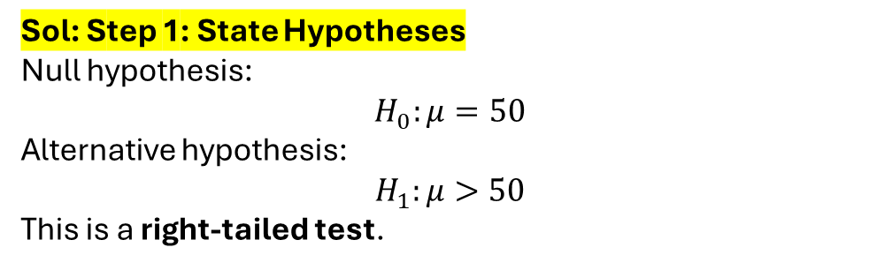
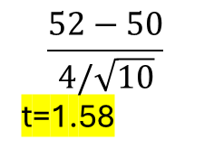
Example: A machine produces rods that should have mean length 50 cm. A sample of 10 rods is taken. Sample mean = 52 cm Sample standard deviation = 4 cm. Test at 5% significance level whether the machine is producing longer rods.
Sol: Step 1: State Hypotheses
Null hypothesis:
$$H_{0}:μ=50$$
Alternative hypothesis:
$$H_{1}:μ>50$$
This is a right-tailed test.
Step 2: Test Statistic
Since:
Population SD not known
Sample size small (n < 30)
We use t-test.
Formula:
$$t=\frac{\overset{ˉ}{x}−μ}{s/\sqrt{n}}$$
$$\frac{52−50}{4/\sqrt{10}}$$
t=1.58

Slide 40
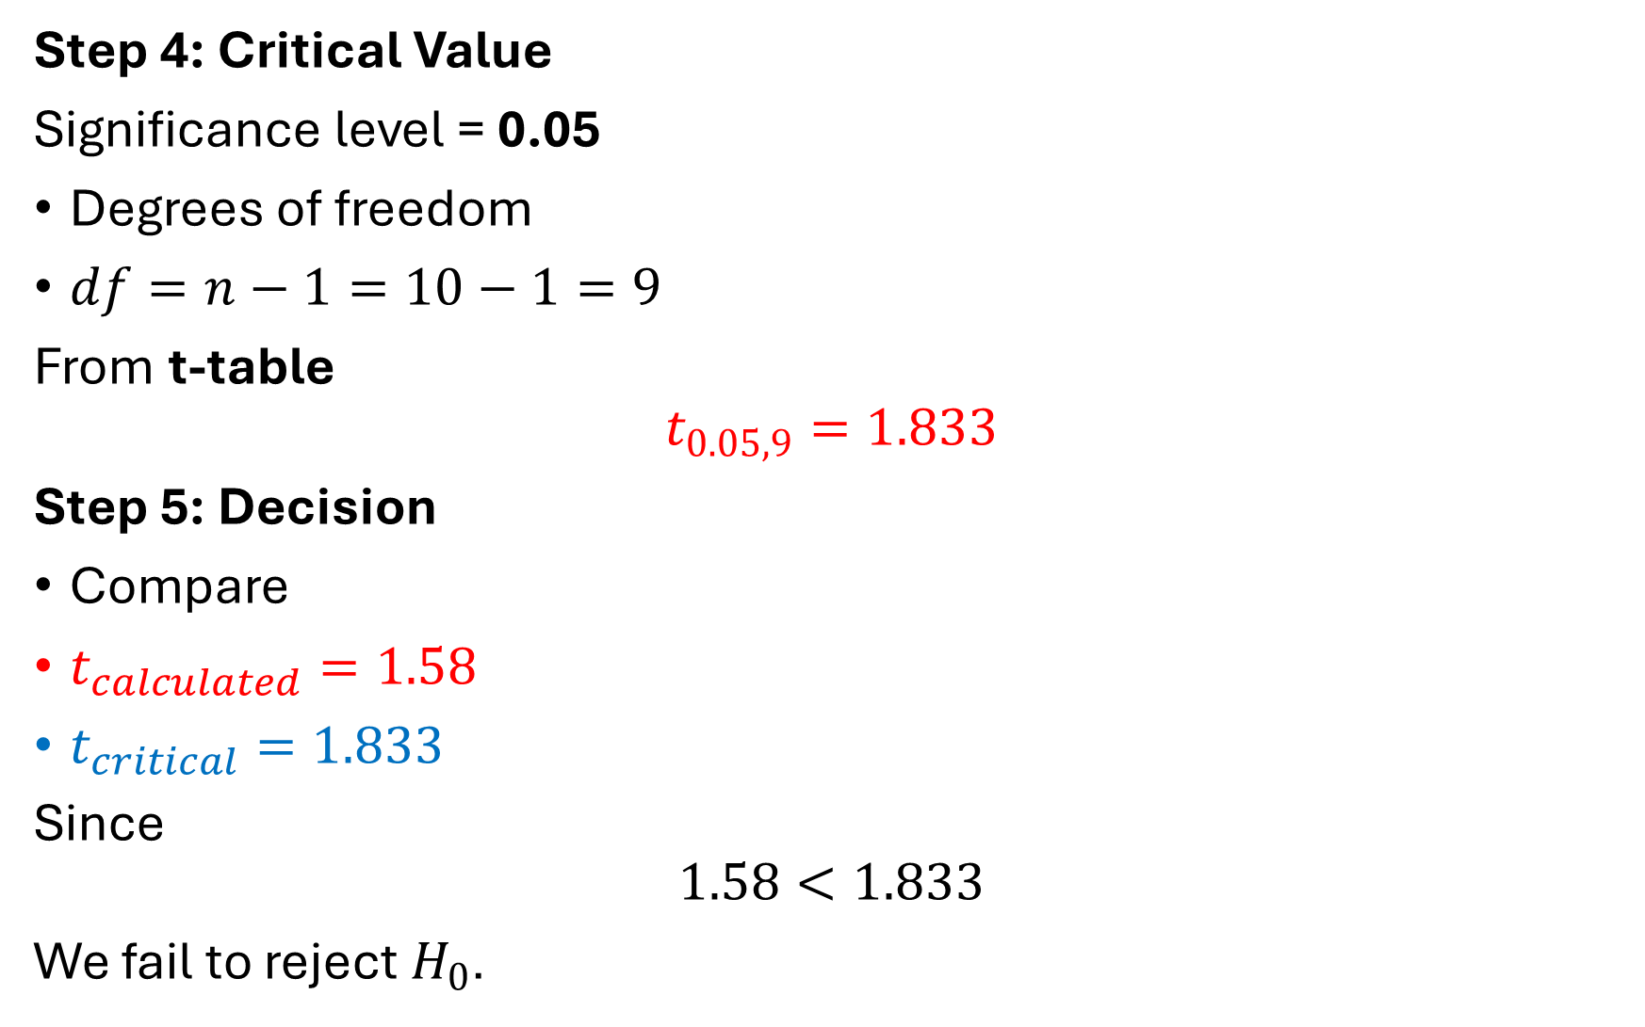
Step 4: Critical Value
Significance level = 0.05
Degrees of freedom
$df=n−1=10−1=9$
From t-table
$$t_{0.05,9}=1.833$$
Step 5: Decision
Compare
$t_{calculated}=1.58$
$t_{critical}=1.833$
Since
$$1.58<1.833$$
We fail to reject $H_{0}$.

Slide 41
Chi-Square Test (χ² Test)
The Chi-Square (χ²) test is a non-parametric statistical test used to analyze categorical data (data in the form of counts or frequencies).
It tests whether the difference between observed and expected frequencies is due to chance or a real effect.
Mainly used in 3 situations
Test | Purpose
Chi-Square Goodness of Fit | Check if data fits a theoretical distribution
Chi-Square Test of Independence | Check if two variables are related
Chi-Square Test of Homogeneity | Compare distributions across groups

Slide 42
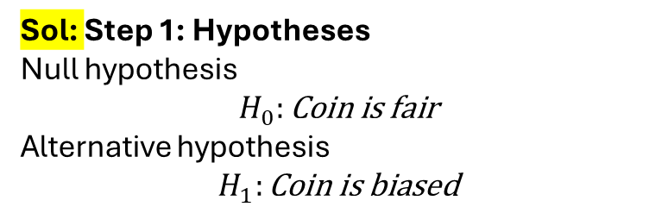


$$\text{χ}\text{²}\text{=}\sum{\frac{{(O−E)}^{2}}{E}}$$
O:Observed Freq.
E: Expected Freq.
Example: A Coin is tossed 100 times and its oberved
Outcome | Observed
Heads | 65
Tails | 35
Test whether the coin is fair at 5% significance level.
Sol: Step 1: Hypotheses
Null hypothesis
$$H_{0}:\text{Coin} \text{is} \text{fair}$$
Alternative hypothesis
$$H_{1}:\text{Coin} \text{is} \text{biased}$$
Step 2: Expected Frequencies
If coin is fair:
$$P\left(H\right)=0.5$$
$$P\left(T\right)=0.5$$
Outcome | Expected
Heads | 50
Tails | 50

Slide 43
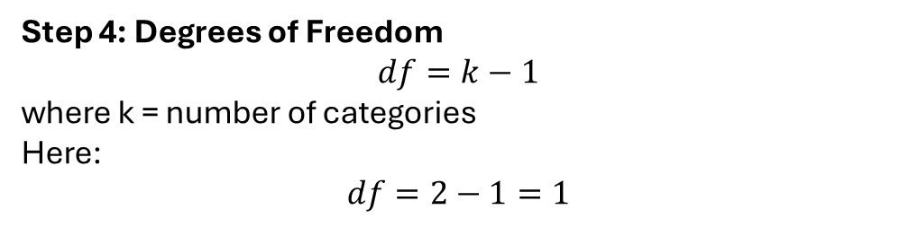
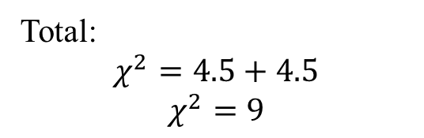

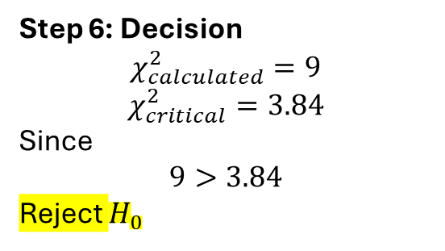
Step 3: Compute χ²
Outcome | O | E | (O−E)²/E
Heads | 65 | 50 | (15²)/50 = 4.5
Tails | 35 | 50 | (−15²)/50 = 4.5
Total:
$$χ^{2}=4.5+4.5$$
$$χ^{2}=9$$
Step 6: Decision
$$χ_{calculated}^{2}=9$$
$$χ_{critical}^{2}=3.84$$
Since
$$9>3.84$$
Reject $H_{0}$
Step 5: Critical Value
At α = 0.05
From χ² table:
$$χ_{0.05,1}^{2}=3.84$$
Step 4: Degrees of Freedom
$$df=k−1$$
where k = number of categories
Here:
$$df=2−1=1$$
There is significant evidence that the coin is biased. The difference is not due to random chance.

Slide 44
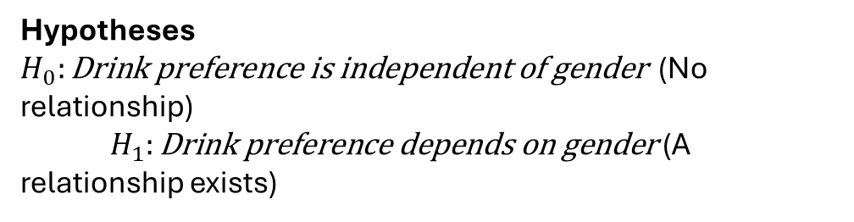
Example 2 (Chi-Square Test of Independence)
The Chi-Square Test for Independence is used to determine whether two categorical variables are related (dependent) or not related (independent)
Sol:
Example
A survey of 100 people:
Gender | Tea | Coffee
Male | 30 | 20
Female | 10 | 40
Test whether drink preference depends on gender.
Hypotheses
$H_{0}:\text{Drink} \text{preference} \text{is} \text{independent} \text{of} \text{gender}$ (No relationship)
$H_{1}:\text{Drink} \text{preference} \text{depends} \text{on} \text{gender}$ (A relationship exists)

Slide 45
Purpose of the Test
Is there a relationship between two categorical variables?
Example: Gender vs Product Preference
If the variables are independent, one variable does not affect the other.
 | Tea | Coffee | Total
Male | 30 | 20 | 50
Female | 10 | 40 | 50
Total | 40 | 60 | 100
We want to know:
Is beverage preference independent of gender?

Slide 46
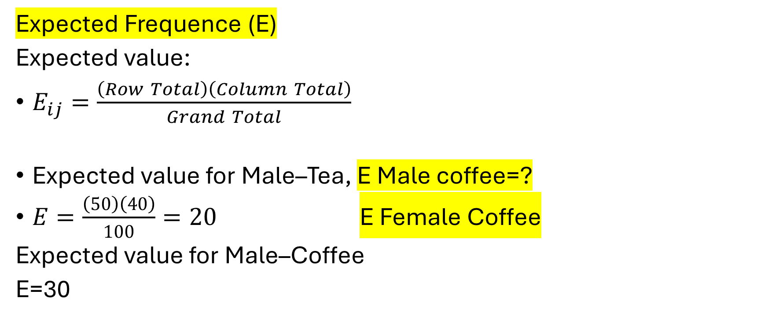
Expected Frequence (E)
Expected value:
$E_{ij}=\frac{\left(Row Total\right)\left(Column Total\right)}{Grand Total}$
Expected value for Male–Tea, E Male coffee=?
$E=\frac{\left(50\right)\left(40\right)}{100}=20$ E Female Coffee
Expected value for Male–Coffee
E=30
Expected Freq. Table
 | Tea | Coffee
Male | 20 | 30
Female | 20 | 30

Slide 47
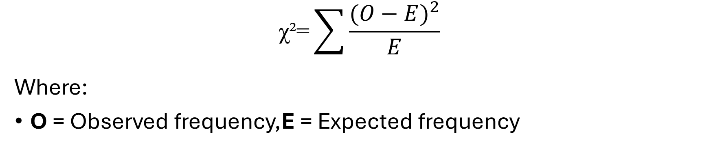
$$\text{χ}\text{²}\text{=}\sum{\frac{{(O−E)}^{2}}{E}}$$
Where:
O = Observed frequency,E = Expected frequency
Col | O | E | (O−E)²/E
Male-Tea | 30 | 20 | 5
Male-Coffee | 20 | 30 | 3.33
Female-Tea | 10 | 20 | 5
Female-Coffee | 40 | 30 | 3.33
χ2=5+3.33+5+3.33=16.66

Slide 48


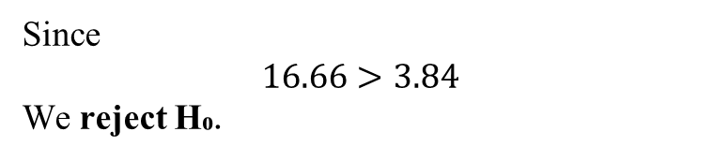
Degrees of Freedom
$df=\left(r−1\right)\left(c−1\right)$
df=(2−1)(2−1)=1
Decision Rule
From the Chi-Square table at:
α = 0.05
df = 1
Critical value:
$$χ_{critical}^{2}=3.84$$
Since
$$16.66>3.84$$
We reject H₀.

Slide 49
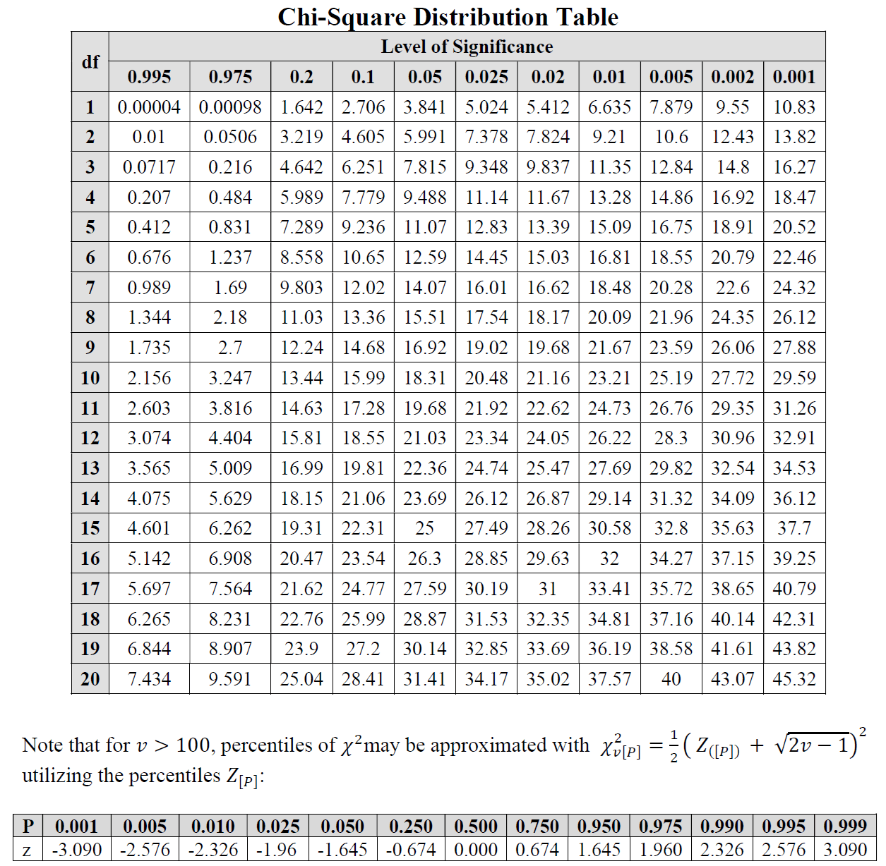

Slide 50
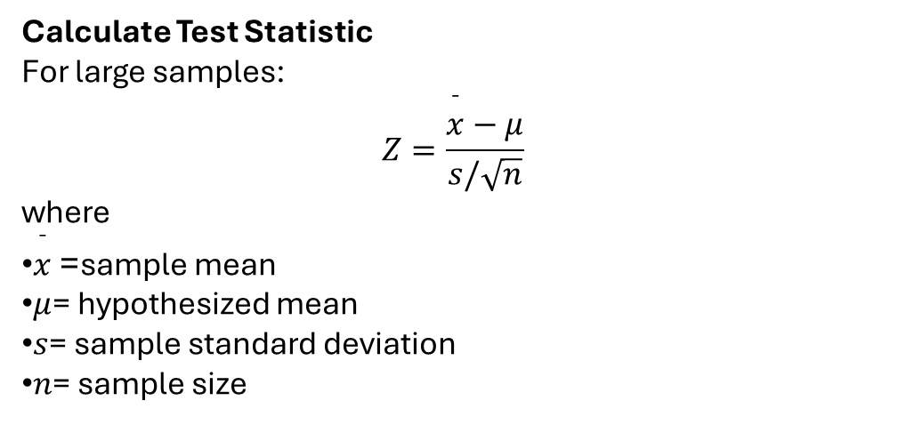
Understanding P-Values
The p-value tells how strong the evidence is against the null hypothesis.
Small p-value means strong evidence against $H_{0}$
Large p-value means weak evidence against $H_{0}$
Calculate Test Statistic
For large samples:
$$Z=\frac{\overset{ˉ}{x}−μ}{s/\sqrt{n}}$$
where
$\overset{ˉ}{x}$= sample mean
$μ$= hypothesized mean
$s$= sample standard deviation
$n$= sample size

Slide 51
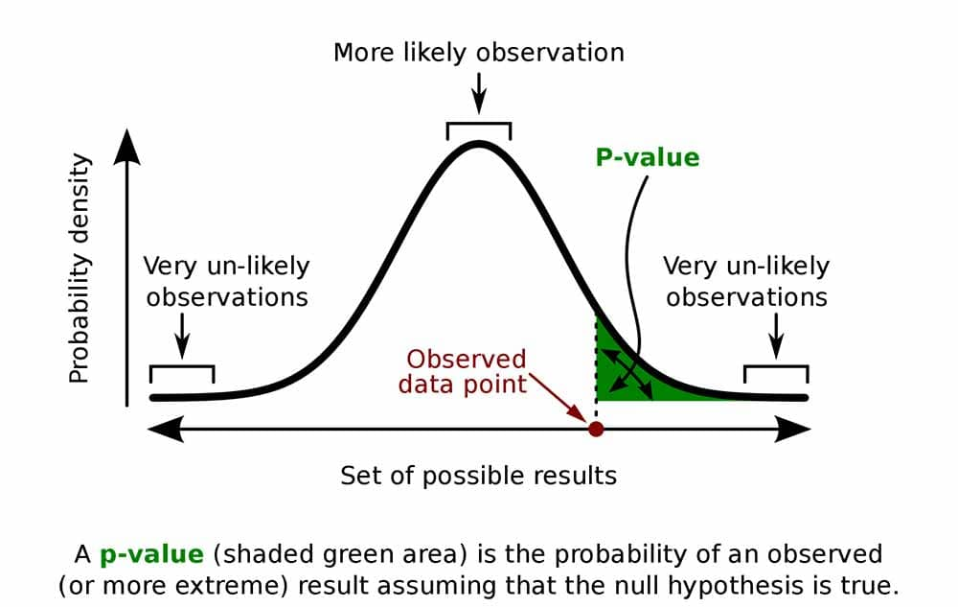
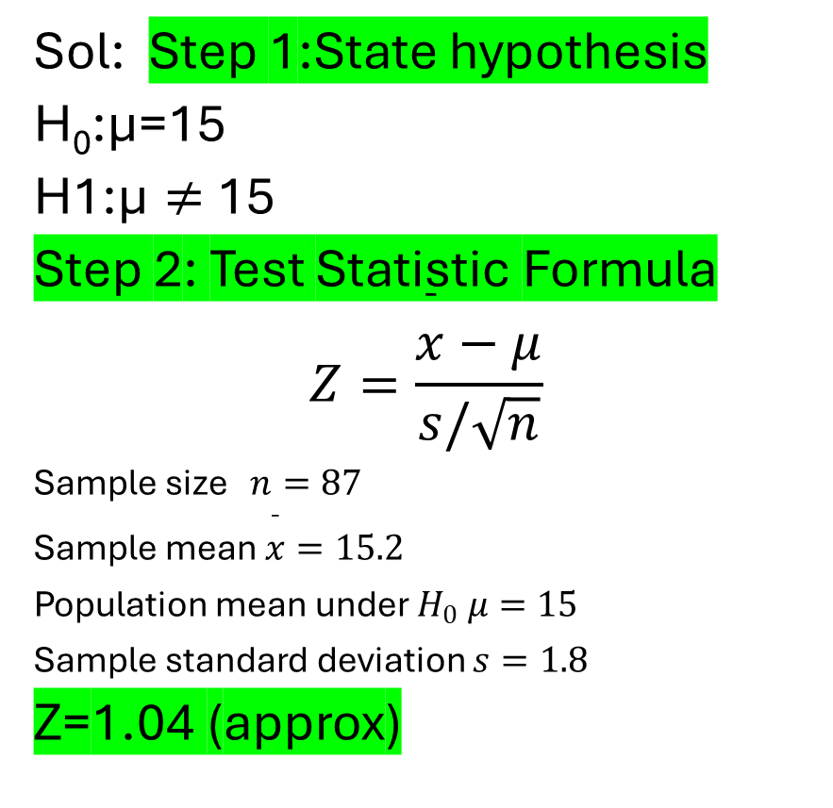
Example 1: A certain type of stainless steel powder is supposed to have a mean particle diameter of μ = 15 units. A random sample of 87 particles had a mean diameter of 15.2 units, with a standard deviation of 1.8 units. A test is made of H0 : μ = 15 versus H1 : μ ̸= 15. (a) Find the P-value. (b) Do you believe it is plausible that the mean diameter is 15 units,
Sol: Step 1:State hypothesis
H₀​:μ=15
H1​:μ $≠$15
Step 2: Test Statistic Formula
$$Z=\frac{\overset{ˉ}{x}−μ}{s/\sqrt{n}}$$
Sample size $n=87$
Sample mean $\overset{ˉ}{x}=15.2$
Population mean under $H_{0} μ=15$
Sample standard deviation $s=1.8$
Z=1.04 (approx)

Slide 52
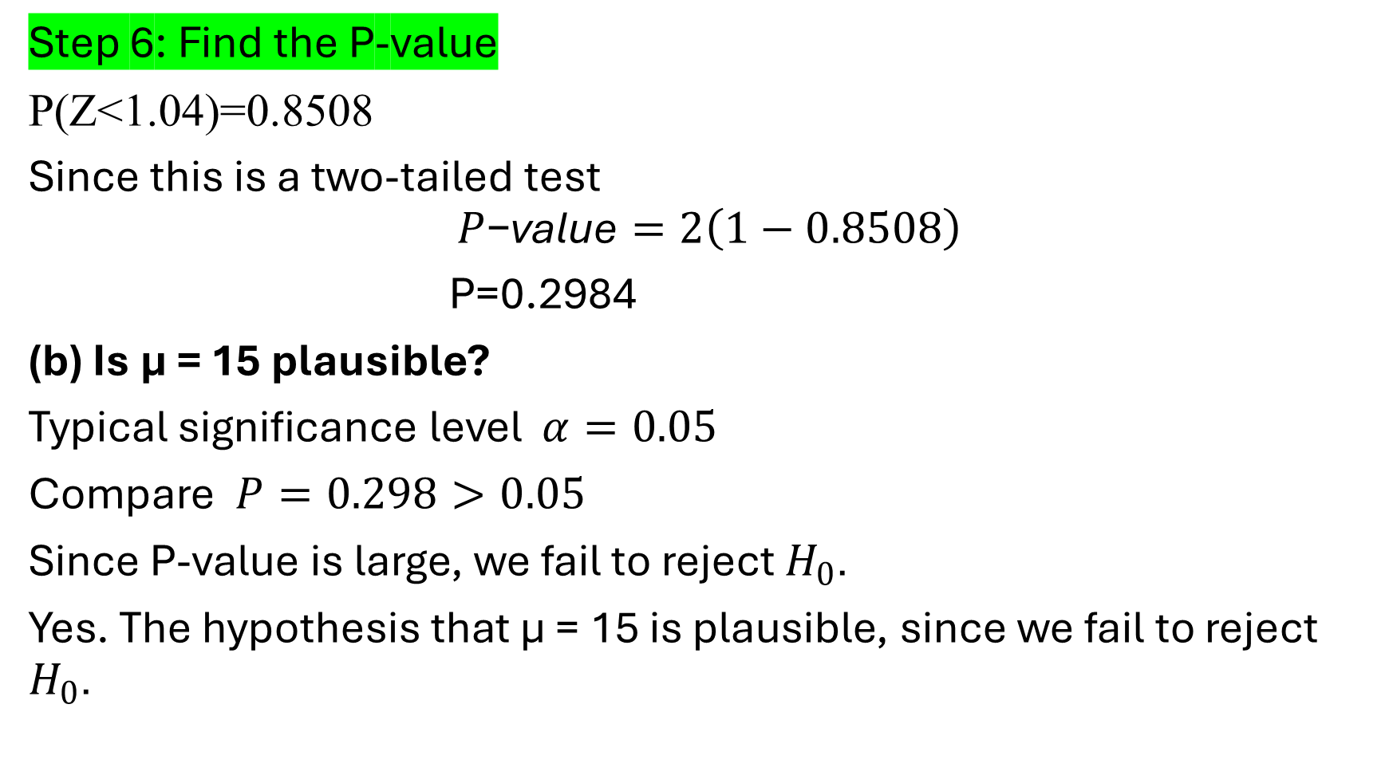
Step 6: Find the P-value
P(Z<1.04)=0.8508
Since this is a two-tailed test
$$P\text{−}\text{value}=2\left(1−0.8508\right)$$
P=0.2984
(b) Is μ = 15 plausible?
Typical significance level $α=0.05$
Compare $P=0.298>0.05$
Since P-value is large, we fail to reject $H_{0}$.
Yes. The hypothesis that μ = 15 is plausible, since we fail to reject $H_{0}$.

Slide 53

NOVA (Analysis of Variance)
ANOVA is a statistical test used to compare the means of three or more groups to determine whether at least one group mean is different from the others.
It extends the idea of the t-test (which compares only two means).
1. Purpose of ANOVA
Are the means of several populations equal?
NULL Hypothesus H0​:μ1​=μ2​=μ3​=...=μk​
Alternative hypothesis:
$$H_{1}:\text{At} \text{least} \text{one} \text{mean} \text{is} \text{different}$$

Slide 54
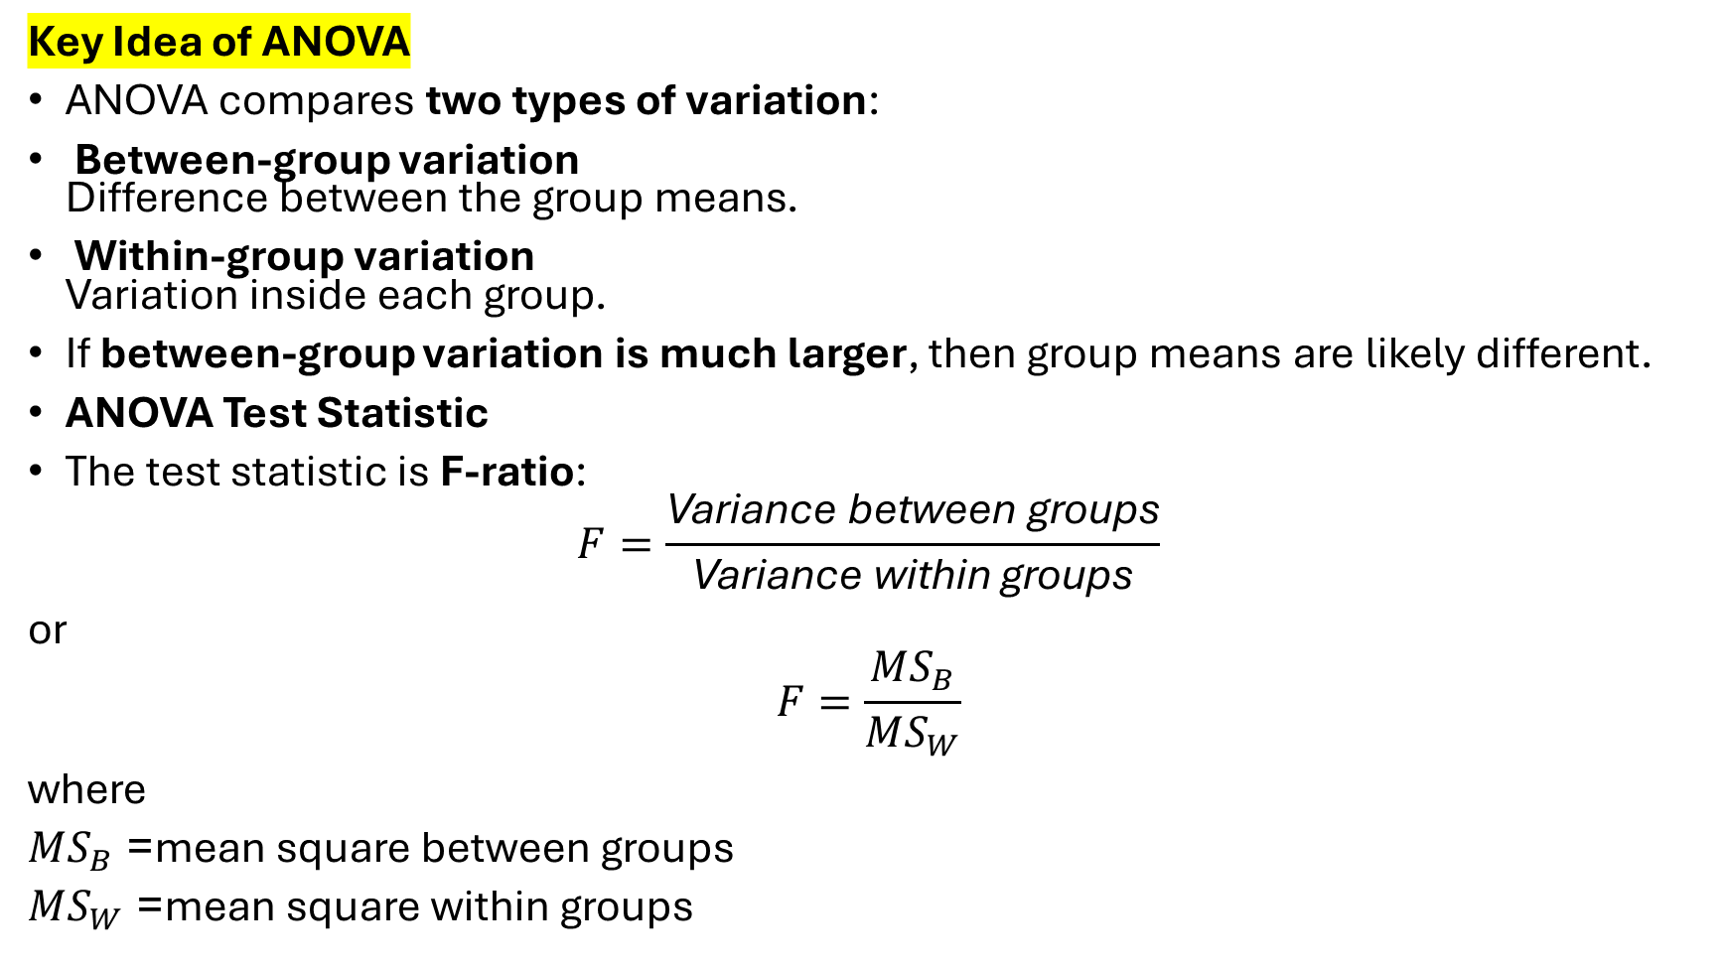
Key Idea of ANOVA
ANOVA compares two types of variation:
Between-group variation Difference between the group means.
Within-group variation Variation inside each group.
If between-group variation is much larger, then group means are likely different.
ANOVA Test Statistic
The test statistic is F-ratio:
$$F=\frac{\text{Variance} \text{between} \text{groups}}{\text{Variance} \text{within} \text{groups}}$$
or
$$F=\frac{MS_{B}}{MS_{W}}$$
where
$MS_{B}$= mean square between groups
$MS_{W}$= mean square within groups

Slide 55
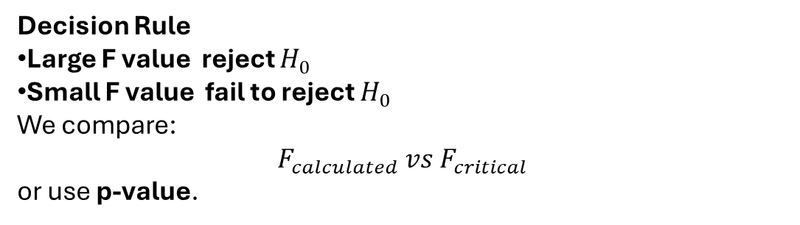
Decision Rule
Large F value reject $H_{0}$
Small F value fail to reject $H_{0}$
We compare:
$$F_{calculated} vs F_{critical}$$
or use p-value.
Example 1: One way ANOVA
Three teaching methods are used for three groups of students. Their test scores are
Method A | Method B | Method C
8 | 7 | 12
9 | 6 | 10
6 | 8 | 13
We want to test whether the teaching methods produce the same mean score.

Slide 56

Step 2: Calculate Group Means
Method A
${\overset{ˉ}{x}}_{1}=\left(8+9+6\right)/3=7.67$
Method B
${\overset{ˉ}{x}}_{2}=\left(7+6+8\right)/3=7$
Method C
${\overset{ˉ}{x}}_{3}=\left(12+10+13\right)/3=11.67$

Slide 57

Step 3: Grand Mean
Total observations = 9
$\text{Grand} \text{Mean}=\frac{8+9+6+7+6+8+12+10+13}{9}$
$=79/9=8.78$
Step 4: Between-Group Sum of Squares (SSB)
Formula
$$SSB=n\left({\overset{ˉ}{x}}_{1}−GM{\left.)\right.}^{2}+n\left({\overset{ˉ}{x}}_{2}−GM{\left.)\right.}^{2}+n\left({\overset{ˉ}{x}}_{3}−GM{\left.)\right.}^{2}\right.\right.\right.$$
where $n=3$.
Method A
$$3\left(7.67−8.78{\left.)\right.}^{2}=3\left(1.23\right)=3.69\right.$$
Method B
$$3\left(7−8.78{\left.)\right.}^{2}=3\left(3.17\right)=9.51\right.$$
Method C
$$3\left(11.67−8.78{\left.)\right.}^{2}=3\left(8.36\right)=25.08\right.$$
$$SSB=3.69+9.51+25.08$$
$$SSB=38.28$$

Slide 58

Step 5: Within-Group Sum of Squares (SSW)
Calculate variance inside each group.
Method A
$$\left(8−7.67{\left.)\right.}^{2}+\left(9−7.67{\left.)\right.}^{2}+\left(6−7.67{\left.)\right.}^{2}\right.\right.\right.$$
$$=0.11+1.77+2.78=4.66$$
Method B
$$\left(7−7{\left.)\right.}^{2}+\left(6−7{\left.)\right.}^{2}+\left(8−7{\left.)\right.}^{2}\right.\right.\right.$$
$$=0+1+1=2$$
Method C
$$\left(12−11.67{\left.)\right.}^{2}+\left(10−11.67{\left.)\right.}^{2}+\left(13−11.67{\left.)\right.}^{2}\right.\right.\right.$$
$$=0.11+2.78+1.77=4.66$$
$$SSW=4.66+2+4.66$$
$$SSW=11.32$$

Slide 59


Step 6: Degrees of Freedom
Between groups
$df_{B}=k−1=3−1=2$
Within groups
$df_{W}=N−k=9−3=6$
Step 7: Mean Squares
$$MS_{B}=\frac{SSB}{df_{B}}$$
$$MS_{B}=\frac{38.28}{2}=19.14$$
$$MS_{W}=\frac{SSW}{df_{W}}$$
$$MS_{W}=\frac{11.32}{6}=1.89$$

Slide 60

Step 8: F Statistic
$$F=\frac{MS_{B}}{MS_{W}}$$
$F=\frac{19.14}{1.89}$
$F=10.13$
Step 9: Decision
From F table
$$F_{0.05}\left(2 , 6\right)≈5.14$$
Since
$$F_{calc}=10.13>5.14$$
Reject $H_{0}$.

Slide 61


